Slide 1
NSTU_ QuickBill
“Sparking a New Era in Billing"

Slide 2

Discussion topics
Non-Functional Requirements
Introduction
Use Case Diagram
Project Purpose
Database Design
Problem Statement
Solution Overview
Tools and Technologies
Functional Requirements
Software Demo

Slide 3
Introduction
In the digital age, Noakhali Science and Technology University (NSTU) seeks to modernize its administrative processes. Enter NSTU_QuickBill, a web-based solution designed to simplify bill submission for faculty members.Traditionally, bill processing at NSTU has been a manual, time-consuming task. NSTU_QuickBill aims to change that by providing teachers, office staff, and administrators with an intuitive platform.Teachers can easily submit bills and track their status, while office staff efficiently manage incoming submissions.

Slide 4

Project Purpose
The main purpose of the NSTU QuickBill project is to modernize and streamline the bill submission and management processes at Noakhali Science and Technology University. By implementing a web-based system, the project aims to enhance efficiency, save time, and optimize resource utilization for faculty members and administrative staff. Ultimately, NSTU QuickBill seeks to foster transparency, accountability, and user convenience in university billing procedures.

Slide 5
Problem Statement
The current exam bill management process at NSTU is inefficient, manual, and prone to errors, with limited transparency and delays in verification. Managing exam committees and panels is unorganized, and the system lacks robust security and accessibility, making it difficult for stakeholders to use effectively.

Slide 6


Solution Overview
NSTU_QuickBill provides an automated solution to streamline bill creation, verification, and approval. It ensures real-time tracking, simplifies exam committee and panel management, and enhances security with role-based access and data protection. The user-friendly and scalable system improves efficiency, transparency, and accessibility, meeting the institution’s needs effectively.

Slide 7
Stakeholders
Primary Stakeholders
Faculty Members (Teachers)
Office Staff
Secondary Stakeholders
Director
DAA Office (Department of Accounts and Audit)
External Auditors and Regulators
Faculty Union or Representatives

Slide 8









Functional Requirements
User Registration and
Login to registered account.
Bill Creation and Submission
Bill Review and Approval

Slide 9

Non-Functional Requirements
Performance:
The system should handle concurrent user requests efficiently, ensuring minimal downtime and fast response times even during peak usage periods.
Security:
The system must implement strong encryption mechanisms to protect user data and ensure secure transmission of sensitive information.
Usability:
The user interface should be intuitive and user-friendly, with clear navigation and well-designed forms for submitting bills and managing user profiles.
Maintainability:
The system should be easy to update, debug, and enhance.Use modular design to support future feature additions or updates with minimal disruption

Slide 10
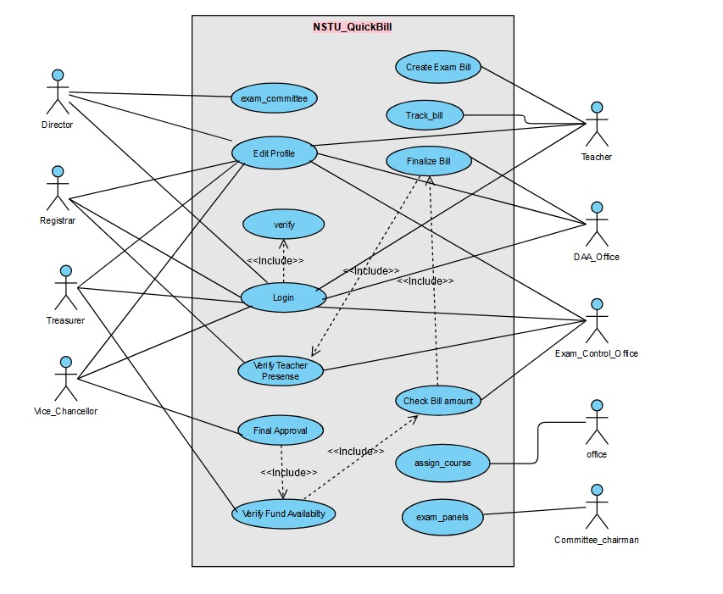
Use Case Diagram:

Slide 11
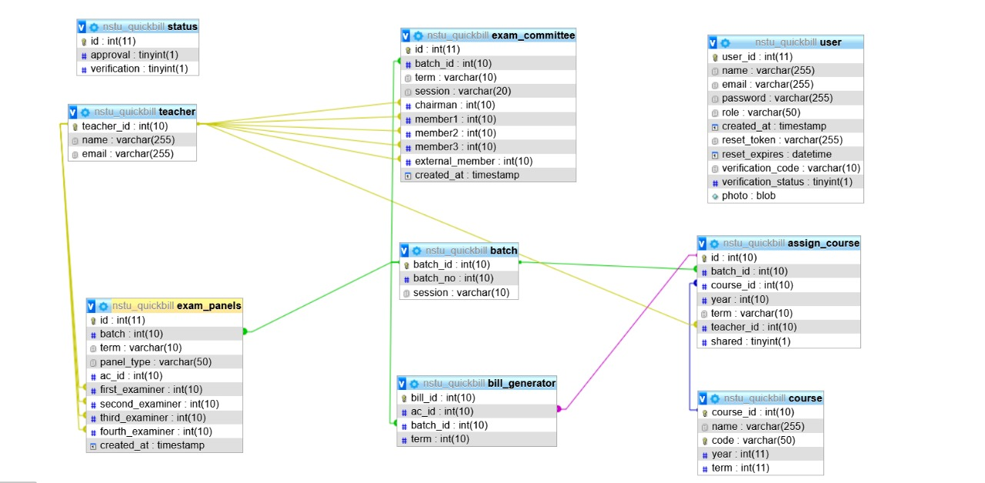
Database Design:

Slide 12
Web Application
(Software Demo)

Slide 13




Expected Benefits
Time Savings
Enhance Efficiency
User Convenience
Cost Reduction
Transparency and Accountability

Slide 14
Tools and Technologies
1
3
5
HTML
MySql
PHP
For markup language and basic structure.
For Database purpose
For backend work
2
4
CSS, Bootstrap
JS , jQuery
For designing purpose
Implementing logic and other purposes

Slide 15
THANK YOU
"True invention arises from a curious mind, a steady hand, and a daring spirit."

